Slide 1


Slide 2
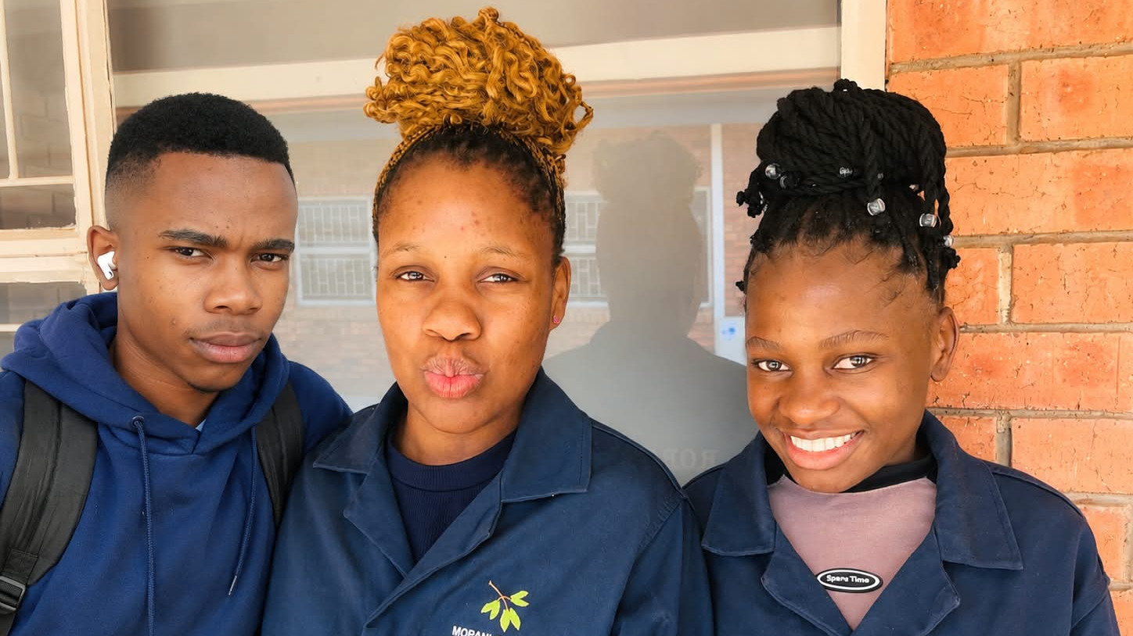
SENOAMADI TJ – AI ENG
LETSIE TR – ELECTRONICS ENG
NAKANA SS – CAD & IoT

Slide 3
Overview
Aether is an intelligent campus safety system. The goal is to help campus security respond, more effective and smarter
Delays in Reporting and identifying location tend to put lives at risk. Traditional emergency systems operate separately, which makes it difficult to access information in one place
We addresses this challenge by bringing required information for response together on one platform.

Slide 4
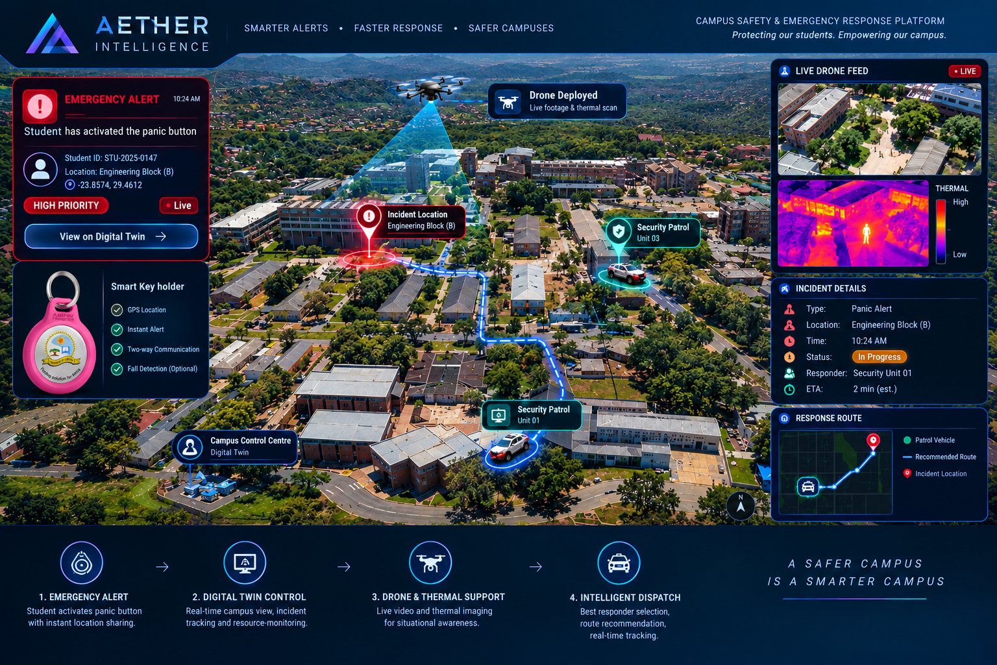
The proposed solution allows student to request emergency assistance through smart panic button integrated into a key holder.
How it works
Once activate, an alert is sent to campus control centre - which displays required information
The security personnel can then carry out appropriate response.

Slide 5
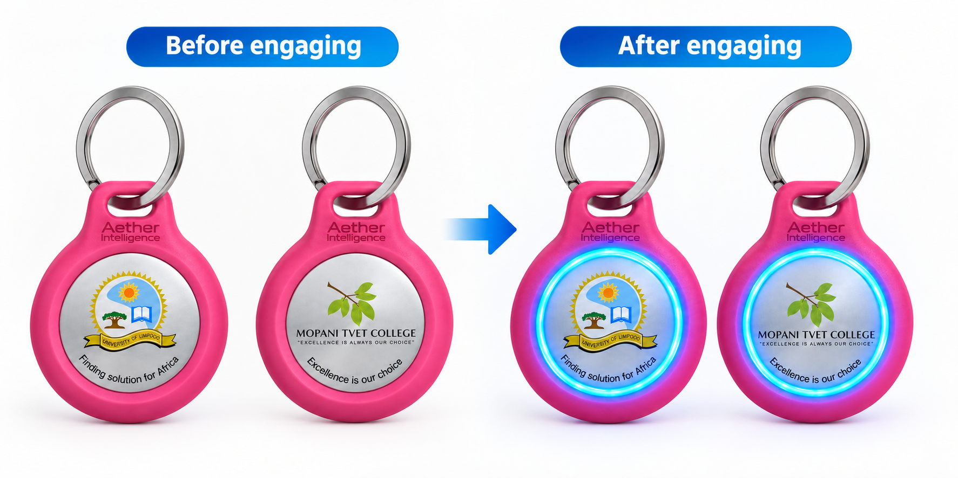
The smart key holder, uses finger print technology to avoid false alert – and it requires press and hold for about 5 seconds where it will flash a blue light to show the emergency is active.

Slide 6
Business Model
Who benefits?
Limpopo residents, students, People Living Alone.
Who pays?
University / SAPS Community (NOT the victim)
Pricing
Wearable: R1 200 estimated cost | R2 200 selling price
Drone: R4 000 estimated cost | R8 000 selling price
Monitoring: R150 per user per month
Pilot: 100 users = R220k + R15k/month monitoring
Scale: 1 500 users = R3.3M + R2.7M/year recurring
Why they buy:
Improve emergency visibility and coordination, and cut response time from 40min to 10min. One failed response costs them millions.

Slide 7

Thank you.

